Slide 1
dbms architecture

Slide 2
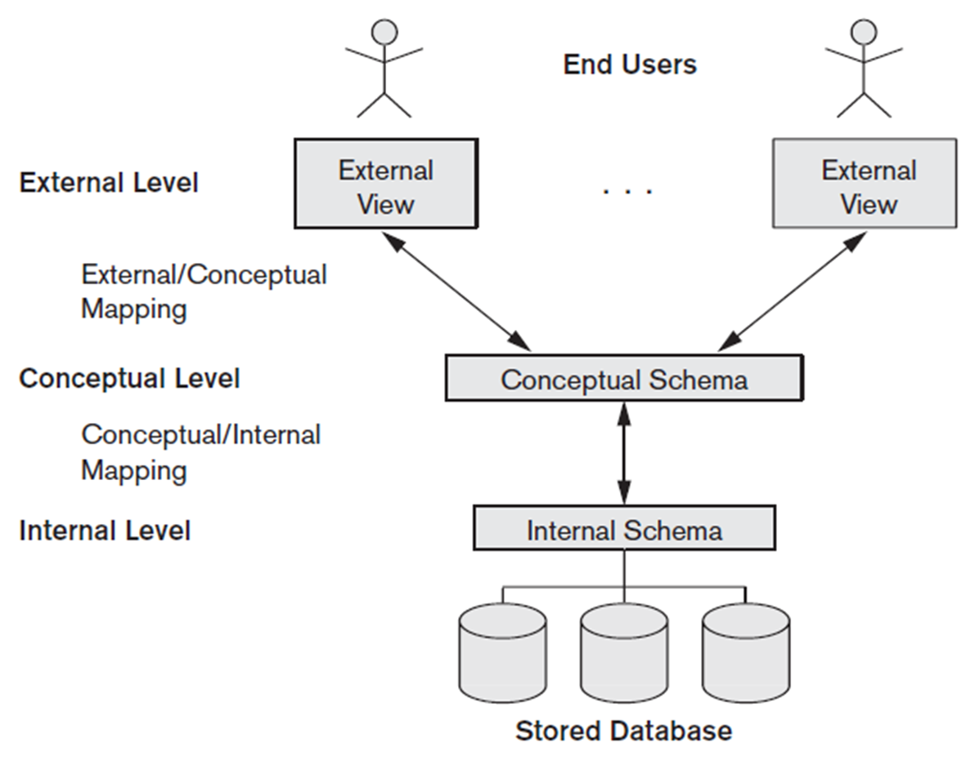
The three-schema architecture:

Slide 3
The Three-Schema Architecture
The goal of the three-schema architecture is to separate the user applications from the physical database.
The internal level has an internal schema, which describes the physical storage structure of the database. The internal schema uses a physical data model and describes the complete details of data storage and access paths for the database.
The conceptual level has a conceptual schema, which describes the structure of the whole database for a community of users. The conceptual schema hides the details of physical storage structures and concentrates on describing entities, data types, relationships, user operations, and constraints. Usually, a representational data model is used to describe the conceptual schema .
The external or view level includes a number of external schemas or user views. Each external schema describes the part of the database that a particular user group is interested in and hides the rest of the database from that user group. An external schema design in a high-level data model.

Slide 4
The three schemas are only descriptions of data; the stored data that actually exists is at the physical level only. In a DBMS based on the three-schema architecture, each user group refers to its own external schema.
The processes of transforming requests and results between levels are called mappings.

Slide 5
Data Independence
The capacity to change the schema at one level of a database system without having to change the schema at the next higher level.
Logical data independence is the capacity to change the conceptual schema without having to change external schemas or application programs.
Physical data independence is the capacity to change the internal schema without having to change the conceptual schema. Hence, the external schemas need not be changed as well.

Slide 6
Database Languages and Interfaces
The data definition language (DDL), is used by the DBA and by database designers to define both schemas.
Another language, the storage definition language (SDL), is used to specify the internal schema.
The view definition language (VDL), to specify user views and their mappings to the conceptual schema.
The DBMS provides a set of operations or a language called the data manipulation language (DML) for manipulation.

Slide 7
DBMS Interfaces
Menu-Based Interfaces for Web Clients or Browsing
Forms-Based Interfaces
Graphical User Interfaces
Natural Language Interfaces
Speech Input and Output
Interfaces for Parametric User
Interfaces for the DBA

Slide 8
Classification of DBMS
The first is the data model on which the DBMS is based.
  relational data model
  object data model
  hierarchical and network data model
The second criterion used to classify DBMSs is the number of users supported by the system.
  Single-user systems
  Multiuser systems
The third criterion is the number of sites over which the database is distributed.
  Centralized
  Distributed
    Homogeneous DDBMS
    heterogeneous DDBMS

Slide 9
The fourth criterion is cost
  Open source (free)
  Paid version
We can also classify a DBMS on the basis of the types of access path options for storing files.
A DBMS can be general purpose or special purpose.

